Slide 1
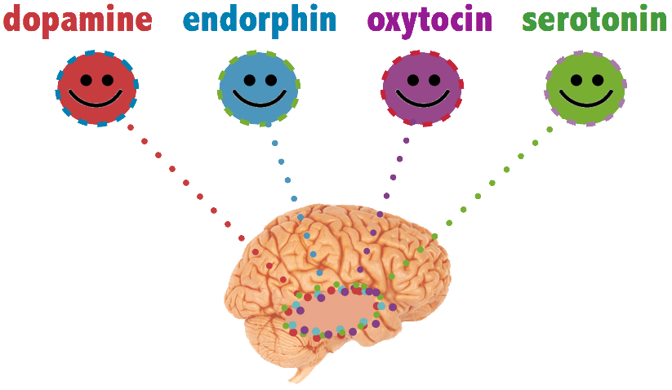
Happy Chemicals
Meet your happy chemicals.
When your brain releases one of these
chemicals you feel good.
Happy chemicals have a special job to do and when they
have finished their job, they turn off.
This is why were always searching for things to turn on our
happy chemicals.
(Loretta Breuning, PhD)
Endorphin = Pain-killer Laughing Watch a funny film/programme Dark chocolate Exercise | Serotonin = Mood Exercise (run/swim/cycle) Sunshine Walk in nature Happy memories | Dopamine = Reward Exploring a new city Completing a task Celebrate a win Eating food (that you enjoy) Doing a self-care activity | Oxytocin = Love Play with a pet Hugging Give someone a compliment Random act of kindness Warmth (bath/shower

Slide 2
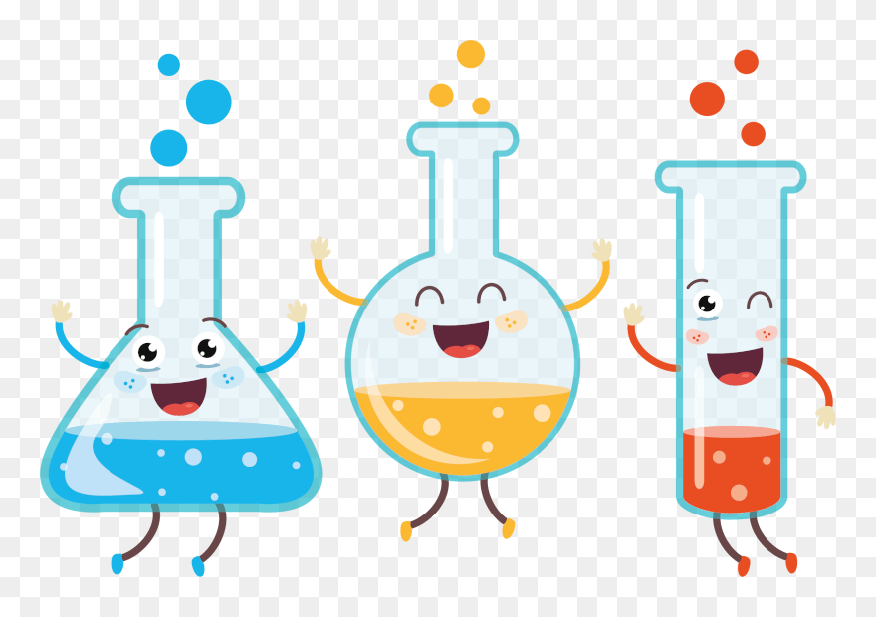
Happy Chemicals Task
Think about the things that release your happy chemicals.
If you’re not sure what releases your happy chemicals, give some of the examples on the first slide a go to see how they make you feel.
If you’re having a bad day, do the things that release your happy chemicals to enhance the way you feel.

