Slide 1
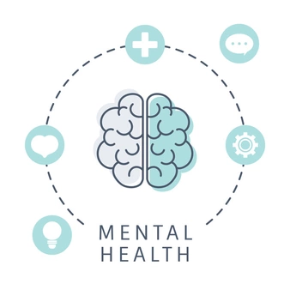
Weekly wellbeing challenge:
Using Brain Dumping to Manage Anxiety and Over Thinking.

Slide 2
This weeks weekly challenge will look at how to effectively use Brain dumping to help manage our feelings and thoughts.
What is brain dumping and how can this help?
There are many coping skills which are helpful for managing anxiety. Brain Dumping is a step above a coping skill. It is a technique. It involves removing the “over thinking” thoughts from your mind and placing them somewhere else. This can help you live more freely throughout each day as the things that are troubling you are being resolved.
Listed in this article are some brain dumping techniques to help choose from to help you get started on becoming free from the symptoms of anxiety, “over thinking” and “ruminating.”
Brain dumping is an exercise in differentiation. It is similar to cleaning out and organizing a closet. The reason it will help with anxiety is because part of anxiety is the problem of too much unresolved clutter in your mind. Brain Dumping helps organize this clutter into workable pieces, which are easier to resolve than a jumbled mess.
There are many different approaches to brain dumping, following this slide is just an option of brain dumping. There are also other versions that you can research to pick a method that best fits your needs. (Medically reviewed by Scientific Advisory Board — Written by Sharie Stines, Psy.D on April 28, 2020)

Slide 3
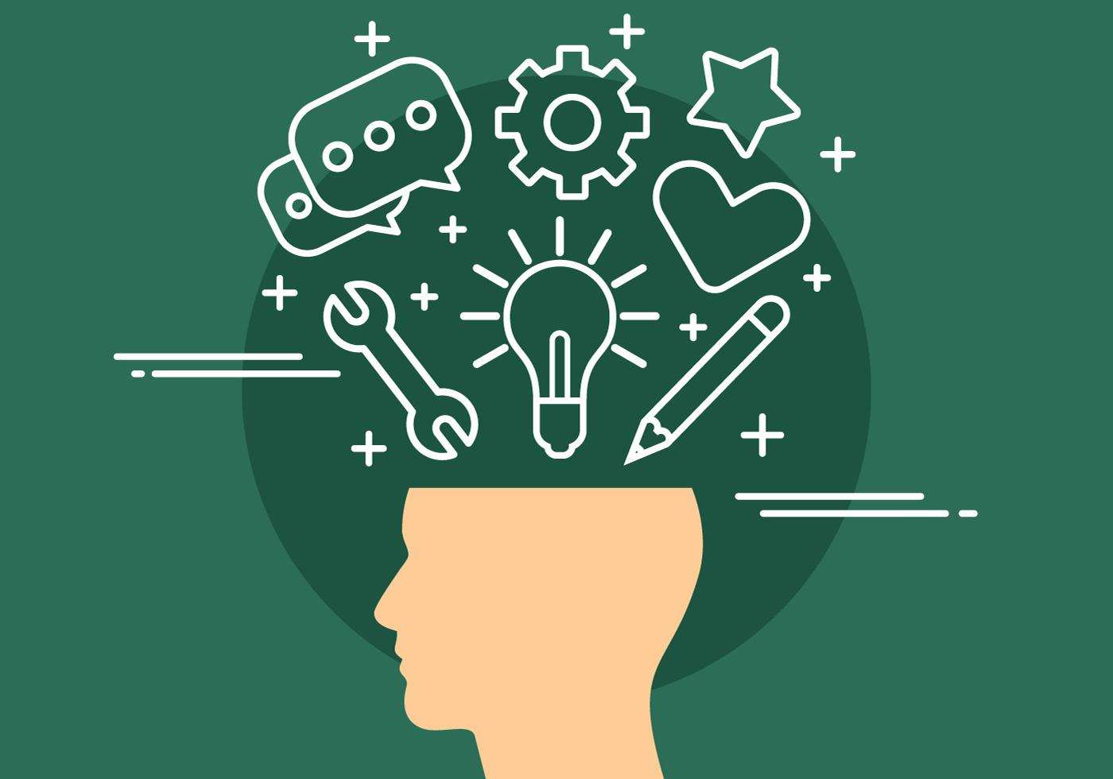
The 3 square Brain dump
This involves dividing your page in to three sections by drawing horizontal and vertical lines across a piece of paper. Label each section with the following titles Thoughts, To Do, and Top 3 Priorities. Here's how you write in each box:
Thoughts: Just write down all your random thoughts without thinking about them too deeply.
To Do: Write down all thoughts related to things you need to accomplish.
Top 3 Priorities: Go back to your To Do list above and write down the top three things on that list that are most important to you.
You can also use this process to begin taking action on the items in your To Do list. You could resolve each day to begin tackling items on this list until they are finished and then move on to your next list. Taking action on the items in your To Do list will help reduce procrastination, which is also a contributing factor to anxiety as well as depression.
(Medically reviewed by Scientific Advisory Board — Written by Sharie Stines, Psy.D on April 28, 2020)

