Slide 1
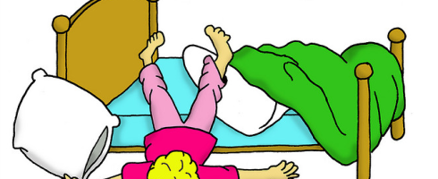
Motivation In Lockdown
This week’s topic will focus on how we can feel more motivated during lockdown.
Perhaps more so than ever, relying on our own determination to do the things we need to do, can be difficult.
No matter how focused we are about what we are doing, motivation to complete tasks can for any number of reasons feel more of a challenge, especially during lockdown.
Previous ways of working and everyday routines are no longer possible and lots of people are experiencing similar feelings and uncertainties
So if you are struggling to start the job, let alone finish it, then don’t worry-you’re not alone!

Slide 2
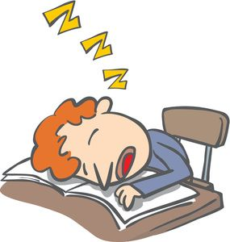
Motivation for learning
If it all seems too overwhelming why not try some of these ideas:
Try to break your day or task down into smaller, manageable parts.
It could be taking notes about a chosen chapter, or watching a video link to your course.
Try not to rush- eat and have regular drinks. Makes sure you have movement breaks – try doing star jumps or marching around the room to get that blood flowing.
Have a mobile detox whist studying and then each hour, check your apps for 5 minutes for a treat.
Speak to parents/carers/siblings if you are finding the work difficult for some support. Or maybe message your friends or classmates to get their opinion or suggestions. They may have advice or pointers about how they stay motivated.
Think about your future school goals or career ambitions, which will inspire you to keep going.

Slide 3

Motivation to have fun!
Socialising during lockdown is very different, but that does not mean you have to stop.
Think about how you can make each day interesting. Here are some ideas:
Have a socially distanced walk with a friend or family member.
Have a virtual film night – arrange a virtual meet or phone call, choose a film together and press play at the same time and watch together!
Plan future days out with your friends and family for you to look forward to
Why not try a virtual bake off - all follow the same recipe- just for fun or make it a friendly competition OR even just cook your favourite meal for tea.
Set up a FIFA tournament – play one game a day for a week at the same time with your friends and see who is the winner of the most games.
Take up a new hobby – surprise yourself and try something new.
Find more ideas at: https://www.bbc.co.uk/bitesize/articles/zvyhpg8

