Slide 1

GCSE Drama Curriculum Overview (OCR)

Slide 2
Drama Vision 2022 onwards…
In the Drama department we aim to celebrate the diversity of our students at Huntington School. We are an all-inclusive department who embraces every individual’s unique starting point. Our curriculum, teaching strategies and extra-curricular opportunities are bespoke to support each individual student on their journey through Drama. We recognise that Drama is a subject in its own right but also is a fantastic tool to explore a vast variety of cross curricular/life skills. We ensure our curriculum is rigorous in the study of the theory of theatre. We embed subject specific vocabulary and aim to excite students about practitioners, genres and theatre history. We aim to build individual’s confidence, develop essential life skills and form mature working relationships so that they have the skills to overcome problems. We aim to inspire creativity where students are challenged in a safe environment where they develop into independent learners and leaders. Enjoyment and appreciation of the Arts is key through engagement with students and parents. In Drama our students become performers, directors, theatre makers, leaders, researchers, deep thinkers and solution focused individuals. We strive for self-discipline and control of rigorously rehearsed and refined skills. Team work is key to a healthy working environment where we encourage and support all learners to be the best they can be.

Slide 3
Truly Great Teaching in Drama
We have High expectations for ALL students, empowering each individual to be best they can be regardless of background.
We know every student as an individual so that we can nurture and support them on their journey in Drama. We create a safe space to enable all students to be brave, take risks and grow in confidence.
We link Drama with ‘Life Skills’ and the real world. Promoting teamwork, problem solving, effective communication, confidence, resilience and curiosity
We make ourselves vulnerable, sharing relevant life experiences, pushing beyond our own comfort zone in performance and being open to share emotions. This sets an example as role models of Drama practitioners to empower students to do the same.
We ensure that we have up to date and accurate subject knowledge. We understand the literacy demands of our subject. We strive to embed our unique vocabulary and metacognitive thinking into our lessons so that students aspire to think, write and perform like Drama practitioners.
We instill a drive and passion for students to be intrinsically motivated by broadening their opportunities to experience a wide range of theatre, past present and future.
We promote independent learning and ownership of their work. As Drama practitioners we continue to learn, putting on many hats as historians, researchers, designers, theatre technicians, directors and actors.
How can I support my child in Drama, as a parent/carer?
Just speaking to your child about their lessons and encouraging them to discuss topics at home will help. In terms of building confidence, the more rehearsal and show back they can do at home the better. If they are writing scripts helping them come up with creative ideas and encouraging them to use the correct format, spelling and punctuation etc. Going over line learning and testing your child on their lines is helpful. Helping them source props and costumes to enhance performances is a valid support. Seeing live theatre is an excellent way that students can see how the profession works. Encouraging practice questions and timed essay writing for the written exam.

Slide 4
Creating
Drama involves working alone or with others to shape ideas into actions and exploring the conventions, resources and techniques, with increasing confidence. Creating drama includes discussion, research, questioning, thinking, sharing ideas and experimenting with different techniques to deepen the understanding of texts and situations. Creativity in drama is imaginative, linguistic and physical. The realisation of ideas and the interpretation of texts involve the selective use of verbal and visual expression to create and convey meanings in an active way.
Performing
Within the context of educational drama ‘performing’ does not necessarily mean taking part in a public performance. Performing refers to the work of a class, group or individual exploring, preparing and sharing ideas through enactment. Pupils may be seen as performing when occupying the dual roles of actor and spectator by commenting on dramatic moments to which they are contributing. Key aspects of performance are: sustaining a role or roles using particular performance styles; giving a coherent interpretation of a role; communicating with an audience using voice, gesture, movement, timing and space; creating a dramatic atmosphere using appropriate lighting, sound and design; working cooperatively with others.
Responding
Responding to drama involves pupils in reflecting on their own experience of drama. They also need to express their understanding of what the drama is saying and how it is saying it through dramatic conventions and techniques. Responses can be emotional or intellectual, individual or shared, spoken or written. During a planned sequence of lessons pupils should be deepening their critical thinking both in and outside the drama. Whether relating to the experience of performing or of seeing a performance, pupils can respond to content, form, character, language, symbolism or impact, and can do so with increasingly analytical insight, using appropriate subject-specific terminology.

Slide 5
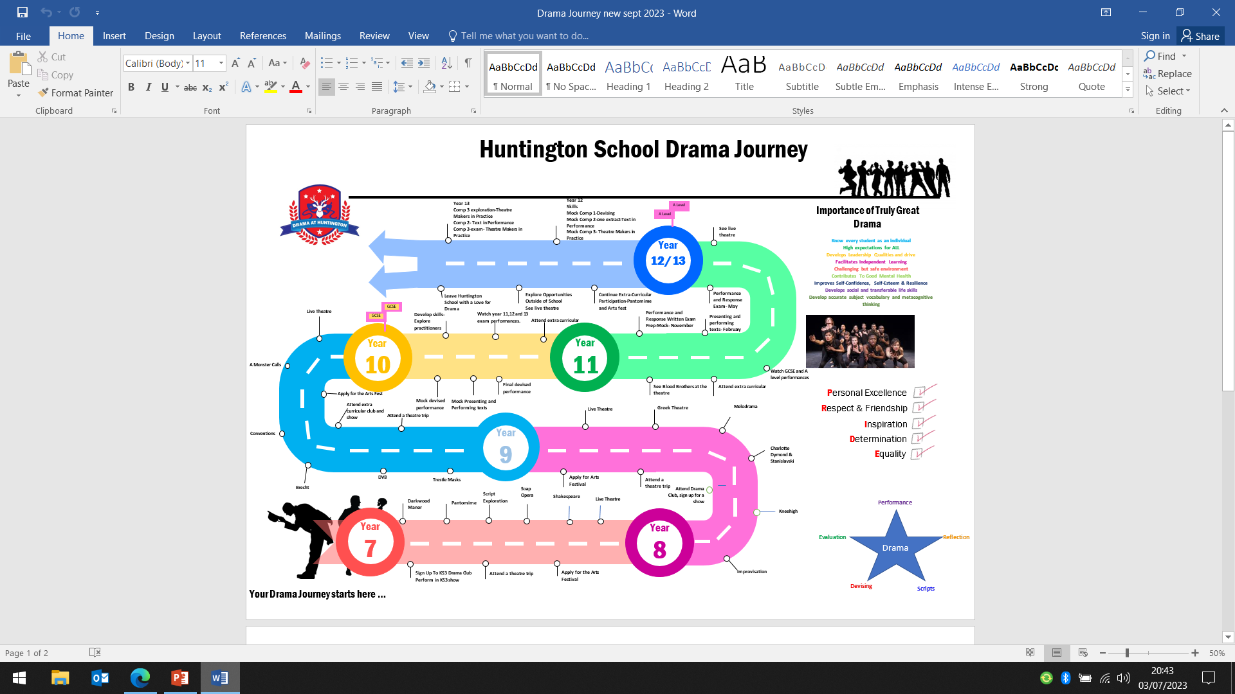

Slide 6
Drama at GCSE
Feedback Policy:
1. There are 2 non examined units. One is internally assessed and one is assessed by the exam board. Teachers are able to review work before it is handed in for final assessment. However, this will be in ‘general’ terms to enable learners to take the initiative themselves in making amendments. General advice will be given during rehearsals and performances; however suggestions on how the assessed piece is to be improved are not allowed to be given directly by the teacher. 2. The third unit is a written examination- externally assessed. 3. Formative assessment is offered throughout the course, which includes one-to-one verbal feedback that identifies strengths and areas for improvement. Small group work, pair work, and solo work is also assessed by monitoring student learning, and teaching. 4. Mock assessments with feedback will take place throughout the course both written and practical. 5. Throughout the year students will receive at least one written feedback from the teacher in the shape of Strengths, Weaknesses and Next Steps on a practical element of the course. 6. Extended learning which is written will be marked and feedback in the form of ‘SWANS’ or ‘Stars and Wishes’ again will be carried out accordingly to the EL. Work may be submitted by hand or on teams. 7. Mock assessments (2 practical mocks and 1 written) and final coursework assessment marks will be recorded on SIMs. 8. Written teacher feedback will be in purple pen, students will write in blue or black unless that are responding to corrections or feedback with which it should then be done in green pen. (Students are given time within lessons to do this). Unless on TEAMS and feedback is typed.
Homework Policy:
Frequency: Homework tasks will be set on a weekly basis. Students are encouraged to work on their own for some tasks, e.g. learning lines, devising scenes. Students are to attend extra rehearsals for the practical work and are encouraged to attend Drama booster sessions to complete and to practise work for the written exam. Teachers will be available at dedicated times to support students with both practical and written tasks.
Types of tasks:
Reinforce and extend learning in class e.g. to practise examination questions.
Learning of key terminology and definitions.
Research in preparation for future tasks e.g. research a character or theme related study for development and progress.
Embed key subject content in long term memory, e.g. the learning of lines or key words used in the written exam.
Practise and develop skills e.g. produce a character profile or a role-on-the-wall.
Completion of coursework tasks e.g. Portfolio- research, diaries, evaluations of practical work. (scaffolding support doc available)
Extension of learning from the lesson e.g. comprehension questions related to key learning.
Revision clocks.
Learning and revision for class mocks and examinations –using Live theatre sheet and GCSE Drama revision guide
Improvement and use of two stars and a wish or SWANs feedback to improve or develop written tasks.

Slide 7
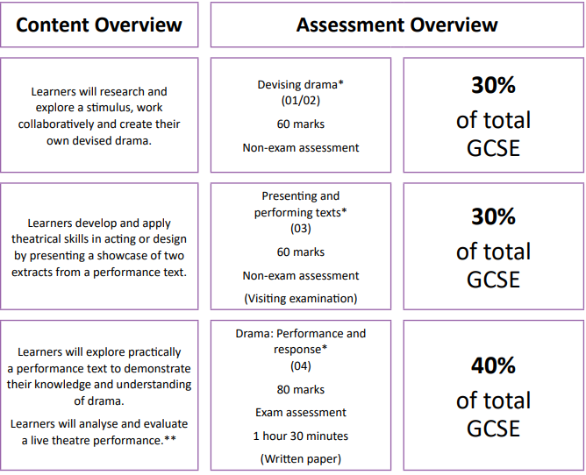
Course Overview
Year 10 | Year 11
Skills/practitioners/genre/ staging Exploration Mock Devising Piece Mock Presenting and Performing Texts Final Devising Piece (30%) | Final Presenting and Performing Texts (30%) Performance and Response (Written Exam 40%)

Slide 8

Devising Drama (30%)
Summary:
Using the booklet supplied by OCR – students will explore a selection of the stimuli, pictures, songs, lyrics, poems etc. Teacher will lead on exploration activities to develop understanding of the stimuli and develop techniques/conventions whilst exploring these. Students will move into groups of 2-6 and plan/explore and devise piece.
Plot initial ideas and storyline/characters and conventions. Rehearse. Devise performance, ensure techniques and variety of abstract elements used and explored. Characterisation work important here too.
Development of technical ideas and tech run with the lighting technician.
Dress/tech rehearsal.
Final performance to live audience. Portfolio to be filtered through lessons and extended learning to support journey.
Key Words:
Stimuli
Devising
Staging
Director
Design
Actor
Facial expressions
Body language
Pace
Walk
Intonation
Proxemics
Audience impact
Conventions
Style
Genre
Set
Costume
Lights
Audience impact
Core Knowledge
Learners should:
Work collaboratively to create, develop, perform and evaluate their own piece of devised drama as either performers or designers.
Learners should know and understand:
Research undertaken and how this has informed the development of the drama or design • how to develop an idea to progress from a simple to a more complex stage • use research to inform creative decisions when devising their drama • examine the social, cultural or historical context of the chosen stimulus • how to plan, create and structure drama • how workshops can move the development of the performance forward • how to rehearse in preparation for a performance to an audience • how to make plans for the structure/form of an artefact – set, costume, lighting, sound • how to edit and adapt the work in progress as a result of new ideas or the development of the drama • how to examine in detail the process of creating drama and measure the impact on a live audience • how to communicate meaning to an audience through engaging drama.
Learners should be able to:
use research to inform creative decisions when devising their drama • examine the social, cultural or historical context of the chosen stimulus -explain how research has impacted on their artistic intentions • show the progression of their idea from initial thoughts to the realised form • select ideas to create engaging drama • clearly document the development of the performance during the devising process through the use of a portfolio • plan for effective use of rehearsals • refine and amend work throughout the devising process so that clear dramatic intentions are communicated to the audience • analyse and evaluate decisions and choices made during the process of creating drama • apply performance or design skills to performance for an audience • explain the changes made to their drama with reference to their artistic intentions and explain the intended impact on the audience • evaluate their final piece of devised drama • use accurate subject specific terminology.
Assessment:
Portfolio:
Section 1 – research and initial ideas.(10 marks)
Section 2 – creating and developing drama including analysing and evaluating the work in progress.
(10 marks)
Section 3 – an evaluation of their final piece of devised drama. (20 marks)
Performance:
Learners also create a final realisation of their devised drama. (5-15 mins in groups of 2-6) (20 marks)
How can I support my child in Drama, as a parent/carer?
Support your child in researching and discussing themes and ideas from the stimuli. Ask your child to perform their piece to you as best they can without others, you could ask them questions and they could respond in character. Read over their portfolio work and check for spelling and punctuation errors etc. Ask them questions on how their performance went and better still give them feedback if you came to watch it. Sourcing costume and props for the performance.

Slide 9
Presenting and Performing Texts (30%)
Summary:
Key Words:
Script
Line learning
Proxemics
Lighting
Costume
Set
Actor
Facial expressions
Body language
Pace
Walk
Intonation
Proxemics
Audience impact
Component 2- Presenting and Performing texts- learners will perform two extracts from one performance text and complete the concept pro forma describing their performance intention. Research into playwright and play. Begin reading scripts.
Component 2- Presenting and Performing texts- discover the artistic intention of a play, understanding the structure and the characters involved. They do this by reading the text, learning about the playwright and researching anything that might be relevant to the period, genre or context of the play. Groupings, explore characters. Blocking
Component 2- Presenting and Performing texts-Why was the play written? Who is it for? How does when it was written affect the content? How are the audience expected to react? Blocking, line learning. Concept proforma found on student L dive –advice to save work in a word doc too in case of problems with PDF. (See notes below on content)
Component 2-Blocking, Line learning. Concept proforma
Component 2- Rehearsal-lighting and costume.
Component 2 –Rehearsal and tidying concept proforma-teacher judgment as to when needs computer rooms etc dependant on group.
Component 2- Presenting and Performing texts Concept pro forma
Component 2- Presenting and Performing texts Concept pro formas sent off week before exam to examiner.
Exam week –visiting examiner watches performances during school day.
Core Knowledge:
Learners should:
•Study two extracts from one performance text • describe their artistic intentions for a performance • present two extracts in a showcase.
Learners should know and understand:
Why the extract is significant in the context of the whole text • the structure of the whole text and the extracts’ place within it • the social, cultural or historical context of the text • the features of the text including: • genre • structure • character • form and style • dialogue • the role of stage directions • how to communicate effectively using: • the semiotics of drama • the skills of a performer or designer • performance conventions • how performance texts can be presented to an audience • the intention of the playwright • theatrical conventions • how to interpret character through voice, movement and language • the use of performance space • the semiotics of theatre as exemplified by the text studied • the relationship between performer and audience • how the different aspects of design impact on the whole creative experience for both performer and audience • the importance of rehearsal including time management and preparation.
Learners should be able to:
• interpret the texts so that the playwright’s intention can be communicated • demonstrate the principles that will underpin their response to the key extracts through performance or design • apply their knowledge of genre, style and theatrical conventions to the way they will perform or design • use performance space effectively • develop a character or design and demonstrate the way it interacts with other characters or with stage artefacts • either: present a complete performance of the extracts with lines learnt, performance rehearsed and refined, performance skills used, intention of the playwright demonstrated and audience engaged • or: present a complete realised design for both extracts with final designs, artefacts, models or sets completed, as appropriate, intention of the playwright demonstrated and audience engaged • use rehearsals effectively to rehearse or make, and to adapt and refine their performance or design as appropriate.
Assessment:
‘Presenting and performing texts’ (03) is externally assessed. This component is non-exam assessment and consists of a performance showcase for a visiting examiner. Learners can take on the role of performer or designer (lighting, sound, set or costume) in this component. This must be assessed during the visiting examiner window in the year of certification. It is worth 30% of the qualification. Component 03 is out of 60 marks. 20 marks are for AO1 and 40 marks are for AO2.
How can I support my child in Drama, as a parent/carer? :
Learning lines is key to this unit and developing characters. Playing the other parts and reading aloud the lines is helpful. Assisting with ensuring regular and effective line learning takes place. Sourcing costume and props. Hot-seating –so asking your child questions that they answer in character.

Slide 10
Performance and Response (40%) Written exam
Core Knowledge continued:
Leaners should:
in Section A: study the development of drama and performance.
Learners must know and understand:
• contemporary staging including: • apron • black box • in the round • promenade• proscenium arch • site specific • thrust • traverse • the role of theatre makers in contemporary professional practice, including: • actors • choreographer • costume designer • director • lighting designer • lyricist • playwright • set designer • sound designer • stage managers • understudy • Acting skills including: • blocking • characterisation • improvisation • vocal techniques an actor might use to communicate a role • communication through physicality and the use of body language, facial expression and gesture • the use of semiotics • the design and use of a set including: • composite sets • non-naturalistic sets • the development of character through the creation and use of: • costume • hair and makeup, masks.
Learners should be able to:
• evaluate the roles that theatre makers (from contemporary professional practice) have on developing, performing and responding to a performance text-state advantages and disadvantages for the decisions made directing, acting and designing for a performance • apply knowledge and understanding of the development of drama and performance to the studied performance text.
Learners should:
in Section B: analyse and evaluate the work of others through watching live drama and theatre.
Learners must know and understand:
the meaning of drama and theatre terminology used by theatre makers • how genre is used in live performance to communicate meaning to an audience • how to analyse a live theatre performance • how to evaluate the work of others, drawing considered conclusions.
Learners should be able to:
• select and use appropriate subject-specific terminology • discuss, analyse and evaluate how meaning is created and communicated through live theatre using their knowledge and understanding of drama • analyse and evaluate the acting, design and the characteristics of the performance text seen.
Core Knowledge:
Learners should:
In Section A: Study a full performance text
Learners must know and understand:
in relation to their performance text: • the contexts of their chosen text including: • social • historical (time set and period written) • cultural • define how the social, historical and cultural contexts have an effect on the chosen performance text • the theatrical conventions of the period in which their text was created • the characteristics of their performance text including: • genres • structure • characters • form and style • theatrical setting (place) • plot and subplot • dialogue • stage directions • how meaning is communicated through: • the use of performance space and spatial relationships on stage • the relationship between performers and audience • the design of: set, props, costume, lighting and sound • an actor’s vocal and physical interpretation of character • the use of performance conventions.
Leaners should be able to:
define how the social, historical and cultural contexts have an effect on the chosen performance text -explore and identify the characteristics of a text through practical preparation work and be able to explain the impact they have on a performance text • select examples from their own practical study which demonstrate knowledge and understanding of the full range of characteristics of the performance text • identify how a range of genres may have been used to inform the characteristics of the performance text • identify how meaning is communicated within the performance text • evaluate the roles that theatre makers (from contemporary professional practice) have on developing, performing and responding to a performance text.

Slide 11
Performance and Response (40%) Written exam
Summary:
Section A:
Research into playwright Willy Russell. Read through of scripts as whole group allocate roles and encourage different accent e.g. RP and Liverpudlian. As travelling through script highlight key points and references to era and time it was written e.g. Marilyn Monroe ref etc.
Continuation of reading script. Option of playing the songs on you tube instead of reading through them-can work nicely. Continue to encourage accents and highlight key points etc. Command words sheet helpful to go through and test.
Ask students to list key themes. Highlight and perform a key scene that shows something about the time in which it is set or written, e.g. dole queue, Mickey and the antidepressants-links to Marilyn Monroe, Skelmersdale-Margaret Thatcher etc.
Use of acting skills to explore characters and scenes practically e.g.: Mickey and Edward as children. Class divide and split scene- contrast in family life. Narrator-power and levels etc. Encourage vocal and physical skills and highlight these. Use a skills table in books to write down ideas using key terms.
Staging sheets with advantages and disadvantages. Ask students to choose a scene and stage it on one of the types of stages, highlight advantages and disadvantages as audience. Ensure all types explored- reposition audience. Can use scripted examples of improvisation.
Use lighting and set sheets. Explore ideas for scenes using examples –link to impact on audience. In groups on A3 paper. Could be practical –layout room as certain scene, use post its to label props and set- explain choices and present to group explaining impact on audience.
Use costume sheets. Design costumes for main characters, could highlight any sound effects and use of song in the piece –link semiotics and impact on audience. Write out a list of props that are mentioned in the script and discuss how these can be used to the actors benefit and what this shows the audience.
Revision Clocks. Can complete ones already completed on system. Can each fill in questions and swap. Can allocate areas for each question to cover e.g set, costume, acting skills etc.
Key Words:
Blood Brothers
Staging
Set
Costume
Lights
Proscenium Arch
Promenade
Theatre in the round
Thrust
Traverse
Characterisation
Themes
Era
Genre
Conventions
Facial expressions
Body language
Pace
Tone
Gestures
Intonation
Pause
Exaggeration
Accent
Semiotics
Proxemics
Historical Context
Audience impact
Assessment:
‘Drama: Performance and response’ (04) is an examined component. Section A consists of short answer questions relating to the study of a text (Blood Brothers). Section B is an extended response analysing and evaluating a live drama performance. It is worth 40% of the qualification. Quality of extended response will be assessed in this component. Component 04 is out of 80 marks. Section A: 50 marks are for AO3. Section B: 10 marks are for AO3 and 20 are for AO4
How can I support my child in Drama, as a parent/carer? :
Attend a live performance of ‘Blood Brothers’ and discuss key themes and issues explored. See if there are some clips on the internet of scenes from ‘Blood Brothers’ watch and discuss the acting skills seen. Encourage revision clocks and practice questions. Use the revision guide purchased through school. Look on the OCR website for practice papers for this unit.

Slide 12
Performance and Response (40%) Written exam
Summary: Section B
To ensure students understand the format of the extended writing questions. Students need to understand the layout of the A3 sheets and the elements they must revise for this extended writing. Acting and Performance Props Lighting Set and Staging Directorial choices Music and Sound Costumes Use rhyme to help remember above. You should include: Intro & conclusion, theatre terminology, A range of key elements, Specific examples, The impact each example had on the audience, If you think it worked (positive/negative impact) Write about ACTOR not character-For each point students must follow this format: Make point (using key terms/skills) Explain point and give specific example Comment on IMPACT on the AUDIENCE Judge if it’s effect was positive/negative
Sentence starter sheets available on the system for vulnerable learners. Add notes to A3 sheet and discuss key points to highlight from production seen. Focus on breaking timings up into elements. Discuss practice questions etc.
Live teacher modelling, use of visualiser and model extended writing answer. Students can take on an element each and spend time writing a paragraph using 4 strand structure. Put all together to make a whole essay. Practice perfecting key introduction format etc.
Use Visualiser to evaluate students work-peer assess etc. Vary elements to write about and allow set time for each section. Embed 4 strand structure. Practice rhyme to remember elements from A 3 sheet.
How can I support my child in Drama, as a parent/carer?
If recording of live theatre available re-watch the performance with your child and discuss key themes, issues and any theatrical skills you could highlight.
Watch actors on TV and evaluate how well they use vocal and skills to create impact on the audience.

