Slide 1

A Level Drama & Theatre Curriculum Overview (Edexcel/Pearson)

Slide 2
Drama Vision 2022 onwards…
In the Drama department we aim to celebrate the diversity of our students at Huntington School. We are an all-inclusive department who embraces every individual’s unique starting point. Our curriculum, teaching strategies and extra-curricular opportunities are bespoke to support each individual student on their journey through Drama. We recognise that Drama is a subject in its own right but also is a fantastic tool to explore a vast variety of cross curricular/life skills. We ensure our curriculum is rigorous in the study of the theory of theatre. We embed subject specific vocabulary and aim to excite students about practitioners, genres and theatre history. We aim to build individual’s confidence, develop essential life skills and form mature working relationships so that they have the skills to overcome problems. We aim to inspire creativity where students are challenged in a safe environment where they develop into independent learners and leaders. Enjoyment and appreciation of the Arts is key through engagement with students and parents. In Drama our students become performers, directors, theatre makers, leaders, researchers, deep thinkers and solution focused individuals. We strive for self-discipline and control of rigorously rehearsed and refined skills. Team work is key to a healthy working environment where we encourage and support all learners to be the best they can be.

Slide 3
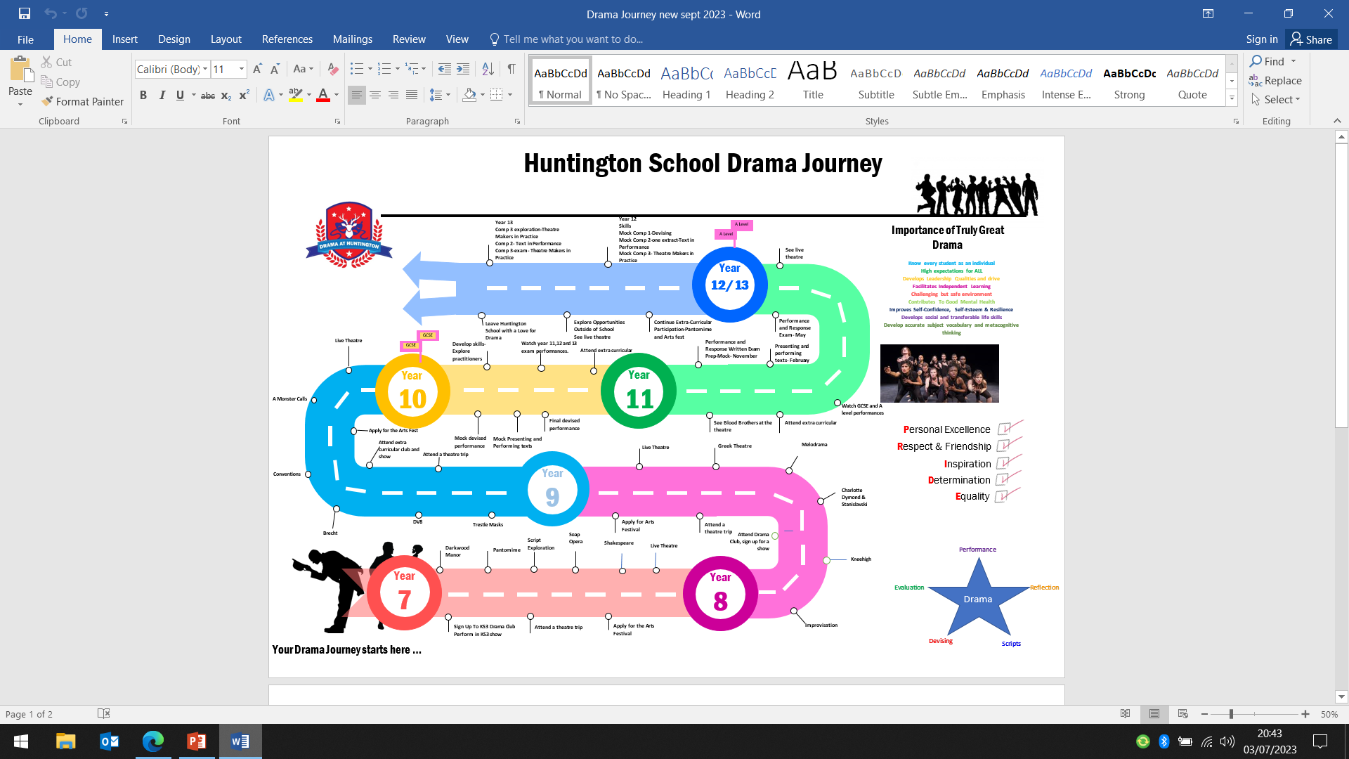

Slide 4
Truly Great Teaching in Drama
We have High expectations for ALL students, empowering each individual to be best they can be regardless of background.
We know every student as an individual so that we can nurture and support them on their journey in Drama. We create a safe space to enable all students to be brave, take risks and grow in confidence.
We link Drama with ‘Life Skills’ and the real world. Promoting teamwork, problem solving, effective communication, confidence, resilience and curiosity
We make ourselves vulnerable, sharing relevant life experiences, pushing beyond our own comfort zone in performance and being open to share emotions. This sets an example as role models of Drama practitioners to empower students to do the same.
We ensure that we have up to date and accurate subject knowledge. We understand the literacy demands of our subject. We strive to embed our unique vocabulary and metacognitive thinking into our lessons so that students aspire to think, write and perform like Drama practitioners.
We instill a drive and passion for students to be intrinsically motivated by broadening their opportunities to experience a wide range of theatre, past present and future.
We promote independent learning and ownership of their work. As Drama practitioners we continue to learn, putting on many hats as historians, researchers, designers, theatre technicians, directors and actors.
How can I support my child in Drama, as a parent/carer?
Just speaking to your child about their lessons and encouraging them to discuss topics at home will help. In terms of building confidence, the more rehearsal and show back they can do at home the better. If they are writing scripts helping them come up with creative ideas and encouraging them to use the correct format, spelling and punctuation etc. Going over line learning and testing your child on their lines is helpful. Helping them source props and costumes to enhance performances is a valid support. Seeing live theatre is an excellent way that students can see how the profession works. Encouraging practice questions and timed essay writing for the written exam.

Slide 5
Creating
Drama involves working alone or with others to shape ideas into actions and exploring the conventions, resources and techniques, with increasing confidence. Creating drama includes discussion, research, questioning, thinking, sharing ideas and experimenting with different techniques to deepen the understanding of texts and situations. Creativity in drama is imaginative, linguistic and physical. The realisation of ideas and the interpretation of texts involve the selective use of verbal and visual expression to create and convey meanings in an active way.
Performing
Within the context of educational drama ‘performing’ does not necessarily mean taking part in a public performance. Performing refers to the work of a class, group or individual exploring, preparing and sharing ideas through enactment. Pupils may be seen as performing when occupying the dual roles of actor and spectator by commenting on dramatic moments to which they are contributing. Key aspects of performance are: sustaining a role or roles using particular performance styles; giving a coherent interpretation of a role; communicating with an audience using voice, gesture, movement, timing and space; creating a dramatic atmosphere using appropriate lighting, sound and design; working cooperatively with others.
Responding
Responding to drama involves pupils in reflecting on their own experience of drama. They also need to express their understanding of what the drama is saying and how it is saying it through dramatic conventions and techniques. Responses can be emotional or intellectual, individual or shared, spoken or written. During a planned sequence of lessons pupils should be deepening their critical thinking both in and outside the drama. Whether relating to the experience of performing or of seeing a performance, pupils can respond to content, form, character, language, symbolism or impact, and can do so with increasingly analytical insight, using appropriate subject-specific terminology.

Slide 6
Drama and Theatre at A level: Feedback
Feedback Policy:
A Level -Drama and Theatre- Edexcel This A level follows a linear structure and is made up of 3 components. The summative assessment of Components 2 and 3 take place in year 13. Component 1 will be completed at the end of year 12.
Component 1
* This is a practical coursework based unit. It is internally assessed and externally moderated.
The written portfolio will receive one formal written and verbal feedback of the Portfolio’s penultimate draft as per requirement of the specification.
* Regular peer and self-evaluation feedback will be part of the lessons.
*Drama staff will support the students through the devising process but not direct the piece.
*At least one ‘Scratch’ performance will be delivered per performance to gain feedback from audience members prior to the exam.
*A mock Portfolio will be completed at the start of year 12. During this time regular written following SWANS or ‘Stars and Wishes” and verbal feedback for guidance will be given.
A minimum monthly Log book checks will be conducted by Drama staff with “Stars and Wishes’ or ‘SWANS’ feedback to help the students to progress.
Component 2
At some stage in the year students will take a Drama written exam. This will test the understanding of key Drama terminology and the skill of analysing their own and others’ performance. Students will be given a final level of progress for the year. This will be based on both the written exam mark and an average of the practical performances marks completed over the 3 terms. Calculation of marks may need amending due to student absence due to pandemic-lockdown etc. accordingly to the EL. Work may be submitted by hand or on teams.
*Mock assessments (2 practical mocks and 1 written) and final coursework assessment marks will be recorded on SIMs.
Written teacher feedback will be in purple pen, students will write in blue or black unless that are responding to corrections or feedback with which it should then be done in green pen. (Students are given time within lessons to do this). Unless on TEAMS and feedback is typed.
*This is externally assessed by a visiting examiner in the final year of the course.
* Staff will provide regular formative and summative verbal and written feedback throughout this component.
*Drama staff will Direct the Group Performance and support the students in their Monologue/Duologue work but not Direct the piece.
*Peer and self-feedback are a regular part of the lessons.
*Filming the performance work will be used as a resource to help to support this.
* A minimum of one ‘Scratch’ performance prior to the exam will be conducted in order to provide audience and staff feedback for the students to make progress.
Component 3
*This is the written exam paper that takes place in the final year of the course. It is externally marked.
*Regular one-to-one verbal and detailed written feedback is given to students for extended learning and independent study tasks throughout this part of the course.
*Detailed written and verbal feedback is given for responses to mock examination questions.
*The whole school marking policy is followed when marking the work.
* Clear ‘Stars and Wishes’ or SWANS as feedback will be used when marking this work. Feedback may be submitted on TEAMS online or by hand and written.

Slide 7
Drama and Theatre at A level: Homework
Frequency: Homework tasks will be set on a weekly basis.
Students will spend 1 hour per lesson on extended learning tasks.
Teachers will be available at dedicated times to support students with coursework and practical tasks.
Types of tasks: To embed key subject content in long term memory, e.g. the learning of lines for Drama and Theatre plays.
Learning and revision for class tests and examinations e.g. cue cards, spider diagrams for essay structure and content.
To prepare and answer questions based on subject content.
Extend learning and reinforce key learning in class e.g. to practise examination questions.
Research in preparation for future tasks e.g. contextual research of plays and time period-Shakespeare/Greek Theatre.
Practise and develop skills e.g. physical and vocal skills.
Completion of coursework tasks e.g. devised and scripted performance pieces, research skills, evaluation of practical tasks, etc.
Extension of learning from the lesson e.g. questions related to key learning.
Reading of literature to support the course.
Timed essay questions.
Strategies to support learners
Check students understand the task, what is required and ensure the tasks are coherently recorded in students’ planners.
Students to explain the task to the teacher/teaching assistant. Printed extended learning slips/practice questions produced for some students.
Students encouraged to attend extended learning club for additional support.
Scaffold extended learning tasks and portfolio work.
MP3 recordings and players for line learning.
Theatre trips funded

Slide 8
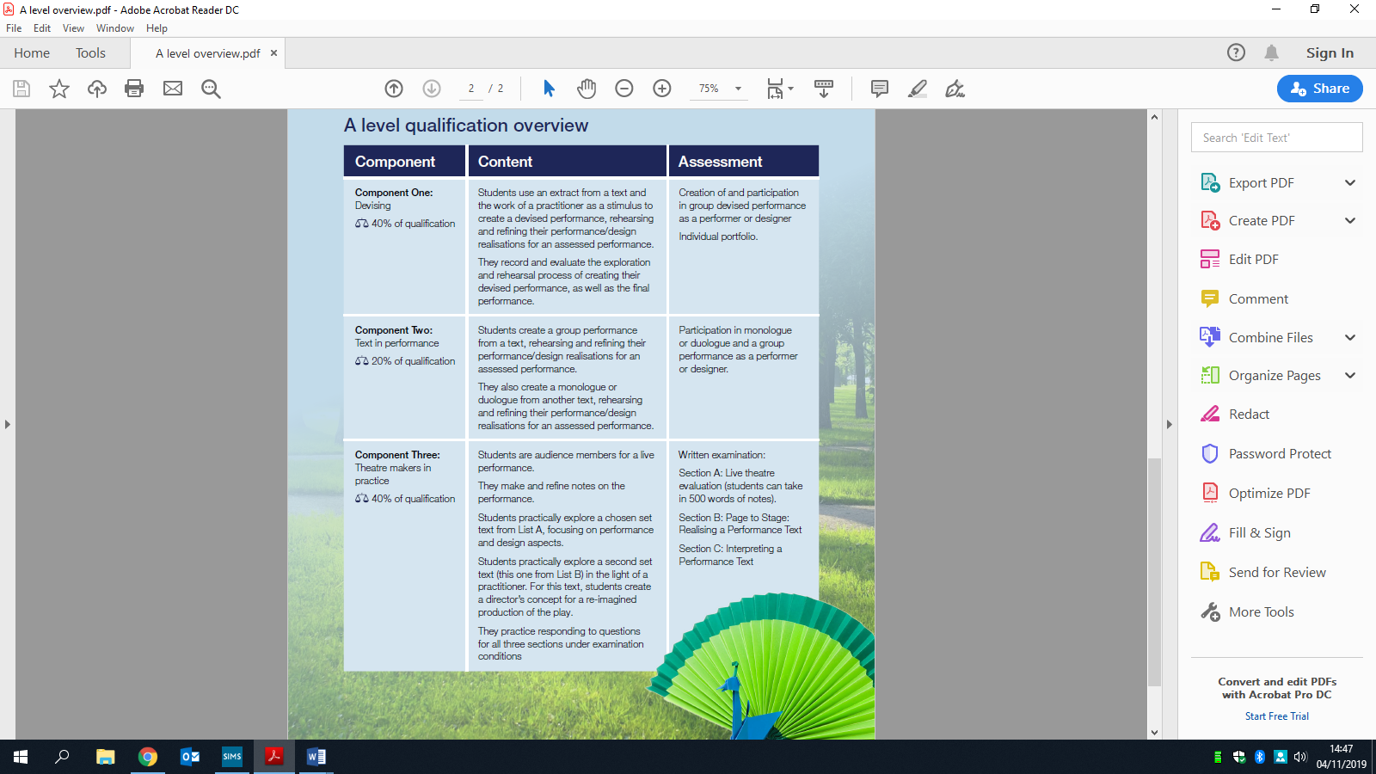
Course Overview

Slide 9
Course Overview
The aims and objectives of this qualification are to enable students to:
● Develop and apply an informed, analytical framework for making, performing, interpreting and understanding drama and theatre
● Understand the place of relevant theoretical research in informing the processes and practices involved in creating theatre and the place of practical exploration in informing theoretical knowledge of drama and theatre
● Develop an understanding and appreciation of how the social, cultural and historical contexts of performance texts have influenced the development of drama and theatre
● Understand the practices used in 21st-century theatre making
● Experience a range of opportunities to create theatre, both published text-based and devised work
● Participate as a theatre maker and as an audience member in live theatre
● Understand and experience the collaborative relationship between various roles within theatre
● Develop and demonstrate a range of theatre-making skills
● Develop the creativity and independence to become effective theatre makers
● Adopt safe working practices as a theatre maker
● Analyse and evaluate their own work and the work of others.
The core skills being developed in this qualification are:
● The ability to recognise and understand the interrelationship between performer, designer and director
● The understanding that texts and extracts studied may represent a range of social, historical and cultural contexts
● The ability to analyse and evaluate their work and the work of others
● The ability to understand how performance texts can be interpreted and performed.

Slide 10
Course Overview
Assessment Objectives
Year 12 | Year 13
FOUNDATIONAL SKILLS Acting Skills/Practitioners and Theatre Makers/Genres/Production Elements/ Performance Skills Mock Component 1: Devising Mock Component 2: Text in Performance Mock Component 3: Theatre Makers in Practice Section A and B Component 1: Devising Practical (40%) | Final Component 1: Devising Portfolio Completion (40%) Final Component 2: Text in Performance (20%) Final Component 3: Theatre Makers in Practice Section A, B and C (40%)
AO1: To create and develop ideas to communicate meaning as part of the theatre making process.
To make connections between dramatic theory and practice.
AO2: To apply theatrical skills to realise artistic intentions in live performance.
AO3: To be able to demonstrate knowledge and understanding of how drama and theatre is developed and performed.
AO4: To be able to analyse and evaluate students own work and the work of others.

Slide 11
Term | Year 12 | Year 13
Autumn 1 | FOUNDATIONAL SKILLS Acting Skills/Practitioners and Theatre Makers/Genres/Production Elements/ Performance Skills/Theatre History MOCK COMPONENT 1: DEVISING Bertolt Brecht and Our Country’s Good by Timberlake Wertenbaker | Final COMPONENT 1: DEVISING Kneehigh Theatre Company and Much Ado About Nothing (Portfolio Focus) EXAM CONTENT COMPONENT 3 SECTION C: THEATRE MAKERS IN PRACTICE Lysistrata by Aristophanes and Bertolt Brecht.
Autumn 2 | MOCK COMPONENT 2: TEXT IN PERFORMANCE That Face by Polly Stenham COMPONENT 3 SECTION A AND B: THEATRE MAKERS IN PRACTICE Live Theatre and That Face set text | EXAM CONTENT COMPONENT 3 SECTION A, B & C Revisited: THEATRE MAKERS IN PRACTICE FINAL COMPONENT 2: TEXT IN PERFORMANCE
Spring 1 | MOCK EXAM COMPONENT 3 SECTION A AND B: THEATRE MAKERS IN PRACTICE Live Theatre and That Face set text Revision and exam technique | FINAL COMPONENT 2: TEXT IN PERFORMANCE
Spring 2 | Final COMPONENT 1: DEVISING Kneehigh Theatre Company and Much do About Nothing | FINAL COMPONENT 2: TEXT IN PERFORMANCE REVISION OF COMPONENT 3 SECTION A, B & C: THEATRE MAKERS IN PRACTICE
Summer 1 | Final COMPONENT 1: DEVISING Kneehigh Theatre Company and Much Ado About Nothing | REVISION OF COMPONENT 3 SECTION A, B & C: THEATRE MAKERS IN PRACTICE
Summer 2 | Final COMPONENT 1: DEVISING Kneehigh Theatre Company and Much Ado About Nothing EXAM CONTENT COMPONENT 3 SECTION C: THEATRE MAKERS IN PRACTICE Lysistrata by Aristophanes and Bertolt Brecht. | REVISION OF COMPONENT 3 SECTION A, B & C: THEATRE MAKERS IN PRACTICE

Slide 12

Component 1: Devising (40%)
Summary:
In this component students will develop their creative and exploratory skills to devise an original performance. The starting point for this devising process will be an extract from a performance text and an influential theatre practitioner. In their creative explorations, students will learn how text can be manipulated to communicate meaning to audiences and they will begin the process of interpretation. They will gain an understanding of how a new performance could be developed through the practical exploration of the theatrical style and use of conventions of the chosen practitioner.
Key Words:
Stimuli
Devising
Staging
Director
Design
Actor
Facial expressions
Body language
Pace
Walk
Intonation
Proxemics
Audience impact
Conventions
Style
Genre
Set
Costume
Lights
Audience impact
Kneehigh Theatre Company
Bertolt Brecht
Verfremdungseffekt
Immersive
Core Knowledge:
AO1: To create and develop ideas to communicate meaning as part of the theatre making process.
To make connections between dramatic theory and practice.
AO2: To apply theatrical skills to realise artistic intentions in live performance.
AO4: To be able to analyse and evaluate students own work and the work of others.
Assessment:
There are two parts to the assessment:
a portfolio (60 marks) recommendations are: - can be handwritten/typed evidence between 3000 words
The devised performance/design realisation (20 marks)
How can I support my child in Drama, as a parent/carer? :
Help your child to learn their lines.
Encourage conversation about their ideas for the devised piece and the process.
Support them with their research into the stimulus.
Proof read coursework for spelling errors and typos.

Slide 13
Component 2: Text in Performance (20%)
Summary:
Students will develop and demonstrate theatre-making skills, appropriate to their role as a performer or designer. They will explore how they realise artistic intentions in performance. The knowledge and understanding acquired though the study of one key extract from a performance text in Component 1 can be applied to assist in the interpretation, development and realisation of key extracts from performance texts. Teaching and wider reading should address the significance and influence of social, historical and cultural contexts on the chosen texts and extracts.
Key Words:
Script
Line learning
Proxemics
Lighting
Costume
Set
Actor
Facial expressions
Body language
Pace
Walk
Intonation
Proxemics
Audience impact
Context
Style
Naturalism
Physical Theatre
Directors vision
Frantic Assembly
Stanislavski
Audience Impact
Core Knowledge:
AO2: To apply theatrical skills to realise artistic intentions in live performance.
Assessment:
Externally assessed by a visiting examiner.
1) Group performance/design realisation: worth 36 marks.
2) Monologue or duologue/design realisation: worth 24 marks.
How can I support my child in Drama, as a parent/carer? :
Learning lines is key to this unit and developing characters. Playing the other parts and reading aloud the lines is helpful. Assisting with ensuring regular and effective line learning takes place. Sourcing costume and props. Hot-seating –so asking your child questions that they answer in character.
Encouraging your child to talk through their characters emotional journey and their directing vision for the piece.

Slide 14
Component 3: Theatre Makers in Practice (40%)
The Written Paper is made up of three main sections
Key Words:
Staging
Set
Costume
Lights
Proscenium Arch
Promenade
Theatre in the round
Thrust
Traverse
Characterisation
Themes
Audience impact
Context
Original Performance Conditions
Sound
Set
Themes
Era
Genre
Conventions
Facial expressions
Body language
Pace
Tone
Gestures
Intonation
Pause
Exaggeration
Accent
Semiotics
Proxemics
Historical Context
Summary:
Section A: Live Theatre Evaluation
● Students answer one extended response question from a choice of two requiring them to analyse and evaluate a live theatre performance they have seen in light of a given statement.
● Students are allowed to bring in theatre evaluation notes of up to a maximum of 500 words
Core Knowledge:
AO3: To be able to demonstrate knowledge and understanding of how drama and theatre is developed and performed.
AO4: To be able to analyse and evaluate students own work and the work of others.
Summary:
Section C: Interpreting a Performance Text
● Students will answer one extended response question from a choice of two based on an unseen named section from their chosen performance text. ● Students will demonstrate how their re-imagined production concept will communicate ideas to a contemporary audience. ● Students will also need to outline how the work of their chosen theatre practitioner has influenced their overall production concept and demonstrate an awareness of the performance text in its original performance conditions. ● Students must take in clean copies of their performance texts for this section, but no other printed materials.
Summary:
Section B: Page to Stage:
Realising a Performance Text
● Students answer two extended response questions based on an unseen extract from the performance text they have studied. ● Students will demonstrate how they, as theatre makers, intend to realise the extract in performance. ● Students answer from the perspective of a performer and a designer. ● Performance texts for this section are not allowed in the examination as the extracts will be provided.
Assessment:
Written Paper 2 hours and 30 mins
The paper is made up of 3 sections.
Section A: Live Theatre Evaluation
●20 marks, assessing AO4.
Section B: Page to Stage:
Realising a Performance Text
● 36 marks, assessing AO3.
Section C: Interpreting a Performance Text
● 24 marks, assessing AO3
How can I support my child in Drama, as a parent/carer?:
Watch live theatre recording at home and discuss key moments, encourage your child to keep on reading the two set texts and ask them questions about it. Eg. Favourite character, plotline etc.
Ask them to talk through their Lysistrata production concept. See as much theatre, live or recorded and discuss with them strengths of the production elements.

